Slide 1
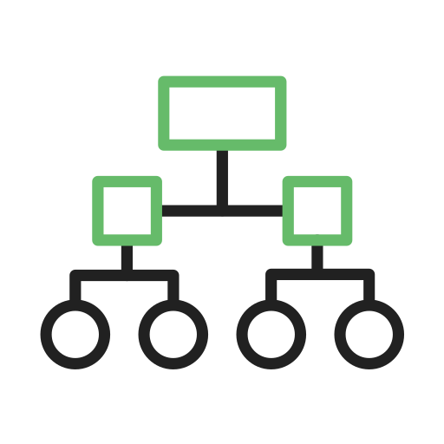
C5.0 Algorithm
Evolution and Features
Impact Session Sameer Chandwaskar (1046), EAP

Slide 2
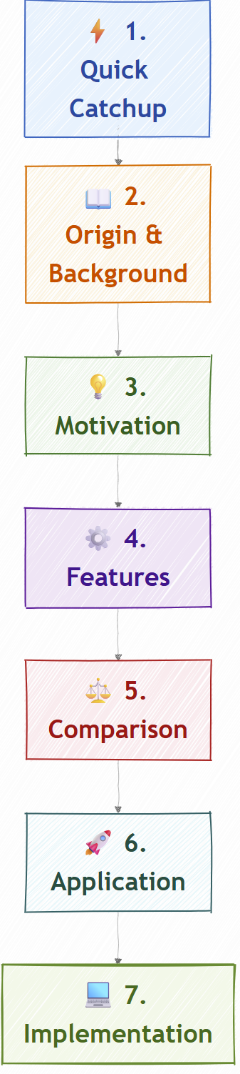

Slide 3
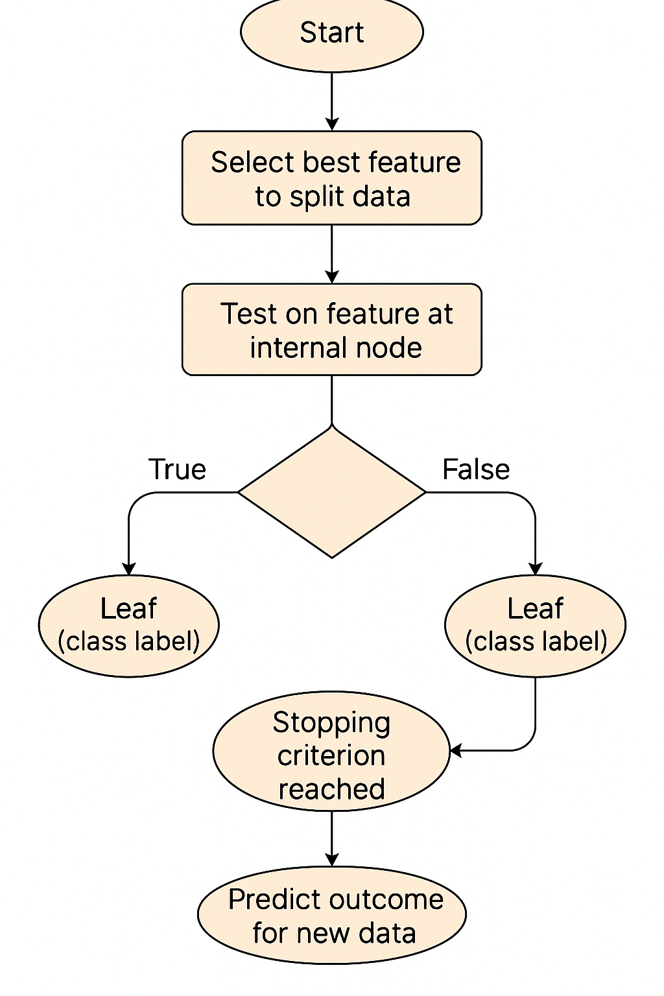
Quick CatchUp
Classification
Decision Trees

Slide 4
Origin & Background
Algorithm | Invented By Ross Quinlan | Description
ID3 | 1986 | The original decision tree algorithm using
C4.5 | 1993 | Improvement over ID3 (handles continuous features).
C5.0 | 1997 | Commercial successor to C4.5 — faster, smaller, and more accurate.

Slide 5
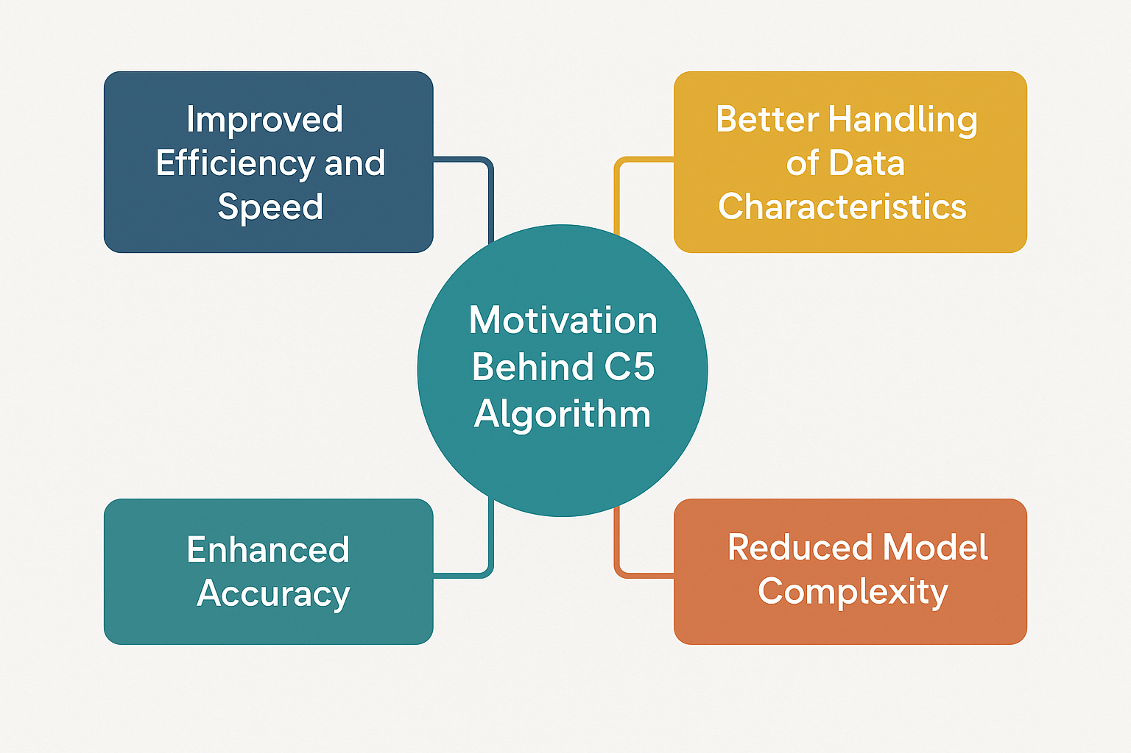
Motivation

Slide 6

C5.0 Algorithm Features
Handling of continuous and categorical data
Pruning
Boosting
Missing Data

Slide 7
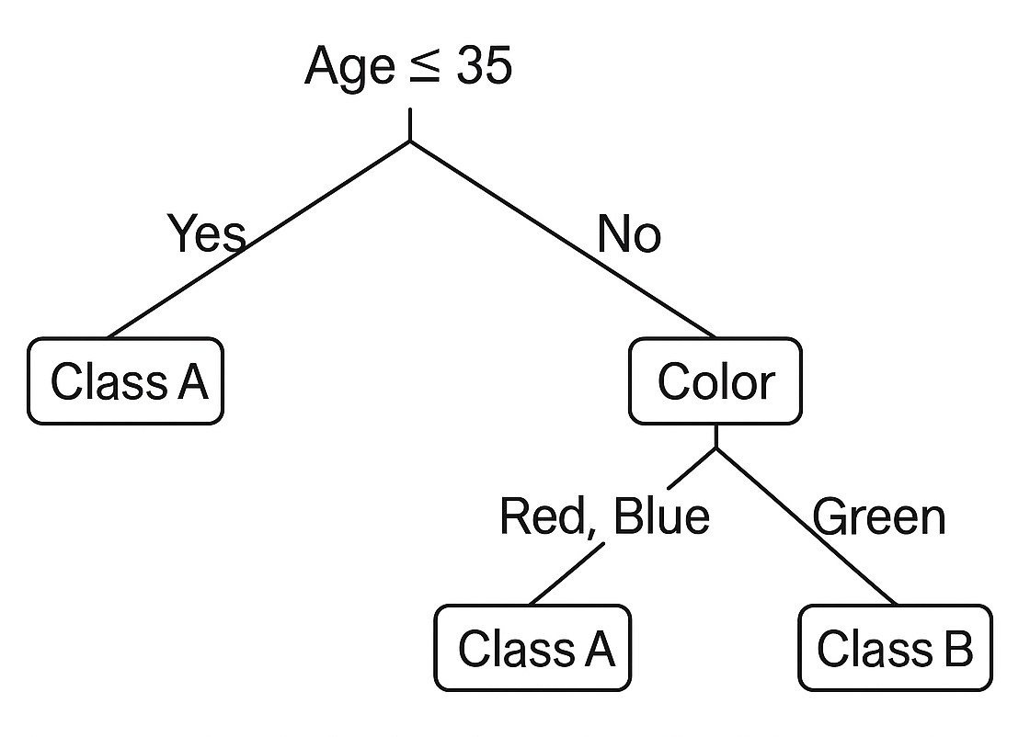
Handling of continuous and categorical data
Age → Continuous variable
Color → Categorical variable
Class → Target label we want to predict

Slide 8
Age | Color | Class
25 | Red | A
30 | Blue | A
40 | Red | B
45 | Green | B
50 | Green | B
55 | Blue | A
60 | Green | A
65 | Red | A

Slide 9
Continuous Variable: Age, Calculating Thresholds
Between | Class Change? | Candidate Threshold
25 & 30 | No | —
30 & 40 | Yes (A → B) | (30+40)/2 = 35
40 & 45 | No | —
45 & 50 | No | —
50 & 55 | Yes (B → A) | (50+55)/2 = 52.5
55 & 60 | No | —
60 & 65 | No | —

Slide 10
Continuous Variable: Age, Calculating Entropy
Entropy= −pA​log2​(pA​) − pB​log2​(pB​)
pA​ = proportion of Class A
pB​ = proportion of Class B
Entropy ranges from 0 (pure) to 1 (max disorder).
Age > 35, ER
Age | Class
40 | B
45 | B
50 | B
55 | A
60 | A
65 | A
3B, 3A
(a) Threshold = 35
Age ≤ 35, EL
Age | Class
25 | A
30 | A
2A
EL = 0
pA = 3, pB = 3, SubsetTotal = 5, DatasetTotal = 7
ER= −(3/5)log2​(3/5) − (3/5)log2​(3/5) = 1.0
WeightedEntropy ​= (2/8)(0)+(5/7)(1.0) = 0.75

Slide 11
(b) Threshold = 52.5
Age ≤ 52.5, EL
Age > 35, ER
Age | Class
25 | A
30 | A
40 | B
45 | B
50 | B
2A, 3B
Age | Class
55 | A
60 | A
65 | A
3A
ER = 0
pA = 2, pB = 3, SubsetTotal = 5, DatasetTotal = 7
ER= −(2/5)log2​(2/5) − (3/5)log2​(3/5) = 0.971
WeightedEntropy ​= (5/8)(0.971) + (3/8)(0) = 0.607

Slide 12
Continuous Variable: Age, Calculating Information Gain
Original entropy (whole dataset): A5, B3
Entropy = −(5/8)log2​(5/8) − (3/8)log2​(3/8) = 0.954
Gain = Entropy − WeightedEntropy ​
Threshold | WeightedEntropy | InformationGain
35 | 0.750 | 0.954 - 0.750 = 0.204
52.5 | 0.607 | 0.954 - 0.607 = 0.347

Slide 13
Categorical Variable: Color
Color | A | B | Total | Class Distribution
Red | 2 | 1 | 3 | 2A, 1B
Blue | 2 | 0 | 2 | All A
Green | 1 | 2 | 3 | 1A, 2B
Entropy = −(5/8)log2​(5/8) − (3/8)log2​(3/8) = 0.954
Split Type | Entropy After Split | Information Gain
Blue vs {Red, Green} | 0.750 | 0.204
Green vs {Red, Blue} | 0.794 | 0.160
Red vs {Blue, Green} | 0.952 | 0.002

Slide 14
Sample
Day | Outlook | Temperature | Humidity | Wind | Play Tennis
1 | Sunny | Hot | High | Weak | No
2 | Sunny | Hot | High | Strong | No
3 | Overcast | Hot | High | Weak | Yes
4 | Rain | Mild | High | Weak | Yes
5 | Rain | Cool | Normal | Weak | Yes
6 | Rain | Cool | Normal | Strong | No
7 | Overcast | Cool | Normal | Strong | Yes
8 | Sunny | Mild | High | Weak | No
9 | Sunny | Cool | Normal | Weak | Yes
10 | Rain | Mild | Normal | Weak | Yes
11 | Sunny | Mild | Normal | Strong | Yes
12 | Overcast | Mild | High | Strong | Yes
13 | Overcast | Hot | Normal | Weak | Yes
14 | Rain | Mild | High | Strong | No

Slide 15
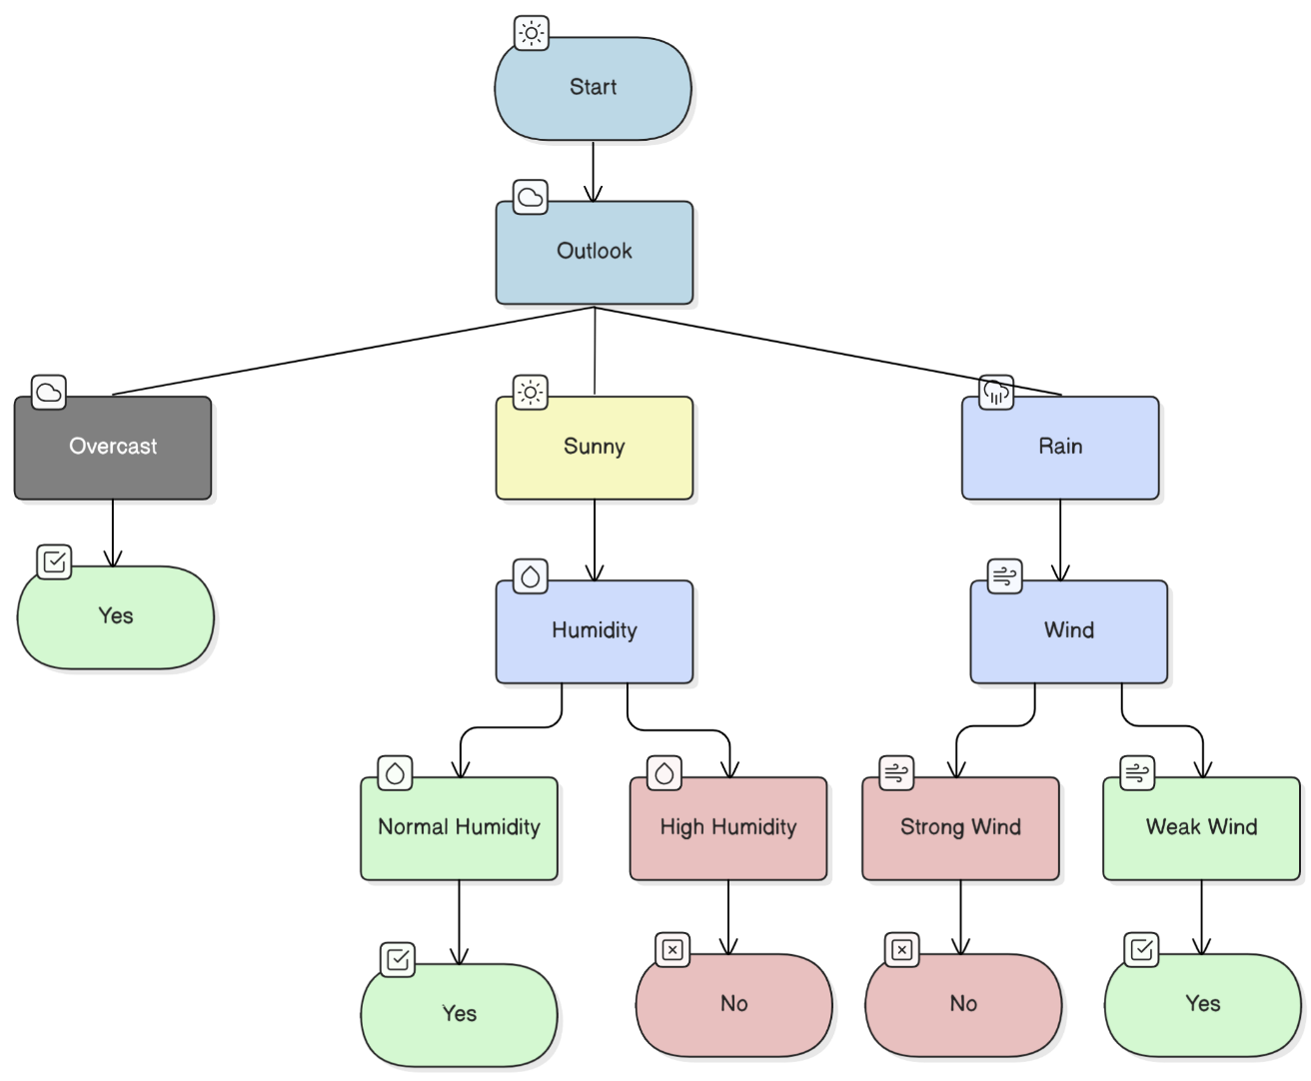

Slide 16
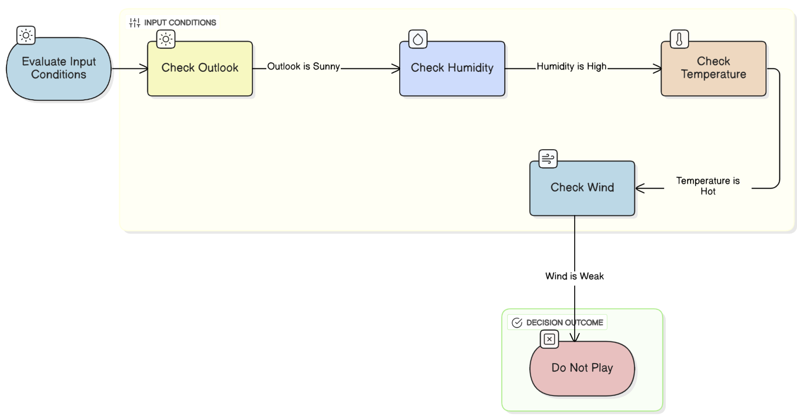
Pruning
- Remove branches that does not contribute to accuracy, Ex: very less in dataset

Slide 17
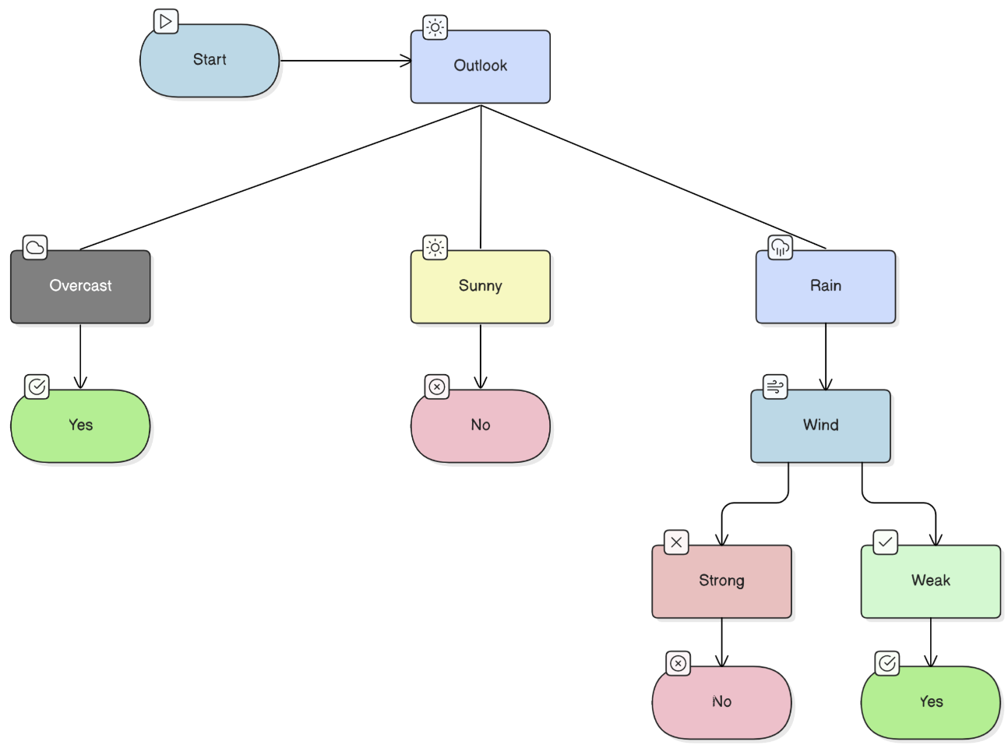
After Pruning

Slide 18
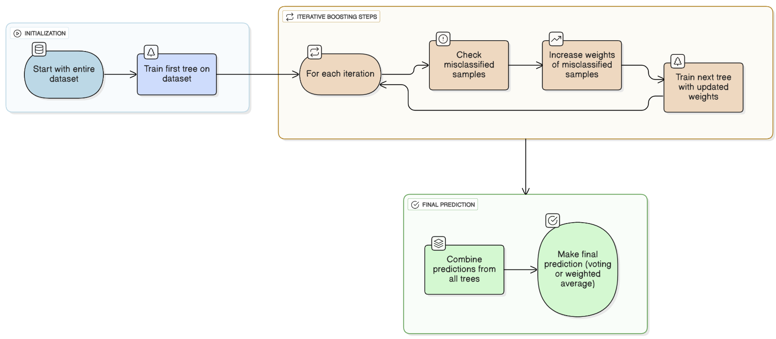
Boosting
- Combining multiple weak trees to create a strong one

Slide 19
Handle Missing Data
Day | Outlook | Temperature | Humidity | Wind | Play Tennis
4 | Rain | Mild | ? | Weak | Yes
9 | ? | Cool | Normal | Weak | Yes
1. Training Phase
Distributes their weight proportionally across possible attribute values
Example: Missing Outlook for Day 9
Outlook Distribution:
Sunny → 5 occurrences
Overcast → 4 occurrences
Rain → 5 occurrences
Total = 14 → proportions are:
Sunny = 5/14 ≈ 0.36
Overcast = 4/14 ≈ 0.29
Rain = 5/14 ≈ 0.36
So Day 9’s record is distributed:
0.36 weight to Sunny branch
0.29 weight to Overcast branch
0.36 weight to Rain branch

Slide 20
2. Prediction Phase
Outlook | Temperature | Humidity | Wind
? | Cool | Normal | Weak
Send this record down all Outlook branches (Sunny, Overcast, Rain)
Weight each path based on training data distribution (e.g., 0.36, 0.29, 0.36)
Collect the predicted class probabilities from each branch.
Combine them using these weights to determine the final prediction.
So if:
Sunny branch → 70% “Yes”
Overcast branch → 100% “Yes”
Rain branch → 60% “Yes”
Then overall probability for “Yes”:
P(Yes)=0.36(0.7) +0.29(1.0) + 0.36(0.6) = 0.25 + 0.29 + 0.22 = 0.76
Predicted outcome: “Play = Yes” (since probability > 0.5)

Slide 21
Comparison with Ancestors

Slide 22
Comparison with Competitors
Feature / Aspect | C5.0 | Naive Bayes | Random Forest | Support Vector Machine (SVM) | K-Nearest Neighbors (KNN)
Algorithm Type | Decision tree (rule-based) | Probabilistic | Ensemble (trees) | Geometric / margin-based | Instance-based
Splitting Criterion | Gain ratio | Bayes theorem | Multiple CART trees | Kernel functions | Distance metric (e.g., Euclidean)
Output Type | Classification only | Classification | Classification & regression | Classification & regression | Classification & regression
Speed | Fast | Very fast | Slower (many trees) | Slower | Slow (depends on dataset size)
Memory Use | Low | Very low | High | Moderate | High
Handles Missing Data | Yes | No | No | No | No
Overfitting Control | Built-in pruning + boosting | Laplace smoothing | Bagging | Regularization (C parameter) | Sensitive to k, distance
Best Suited For | Business analytics, explainable AI | Quick baseline | Complex, high-variance data | Text classification | Small datasets

Slide 23
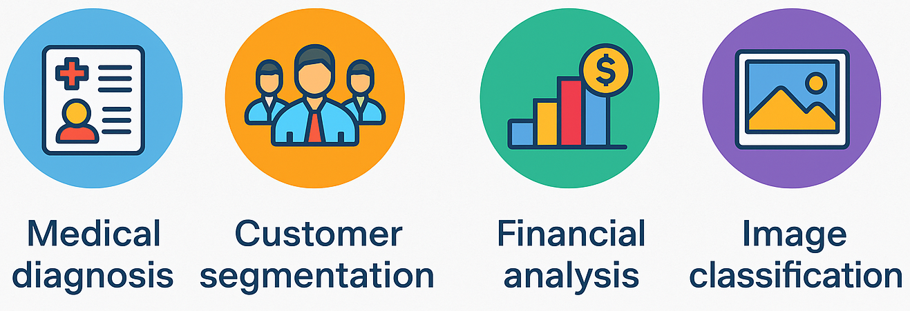
Applications

Slide 24
Implementation
1. Official C5.0 command-line
standalone executables from RuleQuest Research
dataset file with .data and .names extension
c5.0 -f data-file
c5.0 -f data-file -r -b 10 -p test-file.test
2. R's C50 package
3. Python - R Bridge
Calling R's C50 from python
Use rpy2 library to invoke C50
Train & Predict model using scikit-learn way
data-file.tree → decision tree model

Slide 25
Thank you

